Slide 1
Formative Feedback
The single most powerful influence on enhancing achievement is feedback. Hattie, 2009
At best, students receive ‘moments’ of feedback every single day.

Slide 2
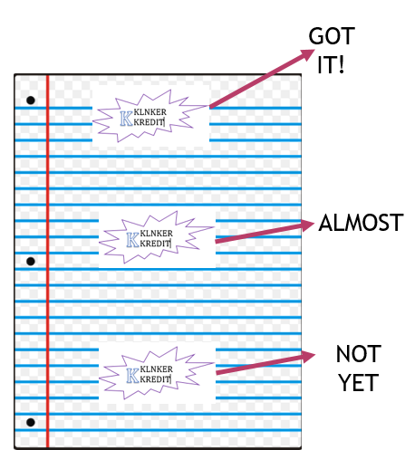
Stamping
After stamping, I move the students to a 3 groups based on where their stamp was on the paper.
Got it – Assist Almost
Not yet – Assisted by me
GOT IT | ALMOST | NOT YET
These students assist the “almost” students. | These students work individually with assistance of “Got It” students. | These students work in circle with me on next assignment.

Slide 3
Pass Back
Could work for several disciplines.
In rows of 5 or 4, depending on criteria on number of problems.
Everyone works on problem or writes answers.
Pass back 1
(grades para 1 only or question 1 only)
Pass Back 2
(grades para 2 or question 2)
Pass Back 3
(grades para 3 or question 3)
…..
Paper goes back to original owner to make corrections.

Slide 4
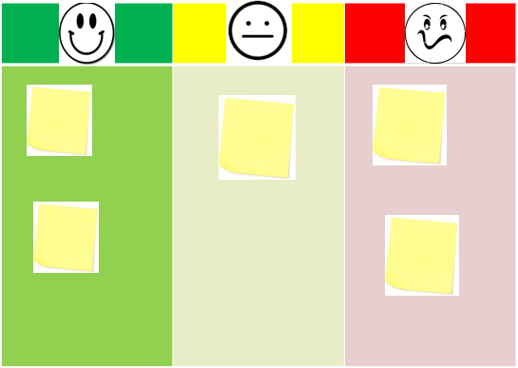
Got It Chart
You could use three differentiated task after this.
This could help instruction the next day.
This could quickly help with grouping.

Slide 5
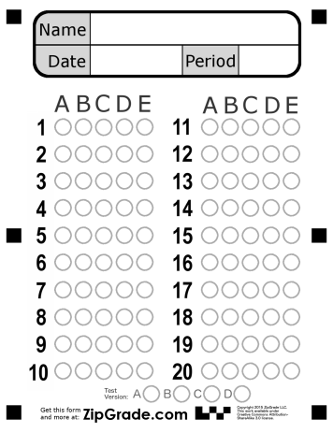
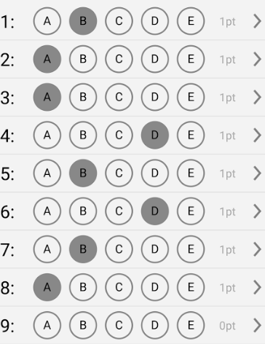
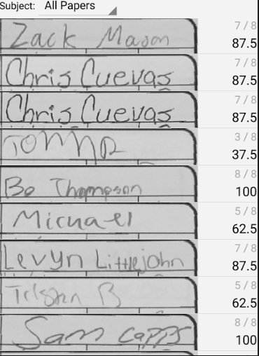
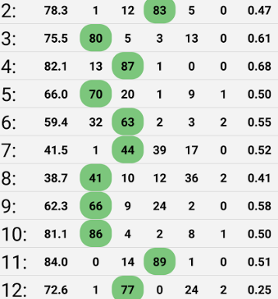
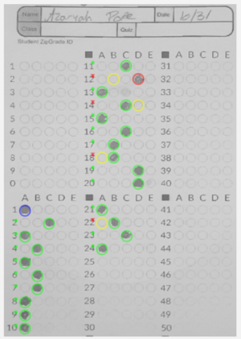
Zip Grade APP
Print Form>Download App>Create Key>Scan>Record Grade>Analyze

Slide 6
Correcting Stations
Create Assignment.
Students complete individually.
Post answers or criteria for each problem around the room.
Allow students to wonder around the room and make corrections.
Students may not change original but instead, state what they could add or change to meet standard.

Slide 7
Coaches
Before the day of the stations, I assign experts to complete their station for homework.
The next day, I have students rotate through stations.
Coaches check and help students and weak areas.
Coaches then write feedback to me on areas of weaknesses at the end the activity.

Slide 8
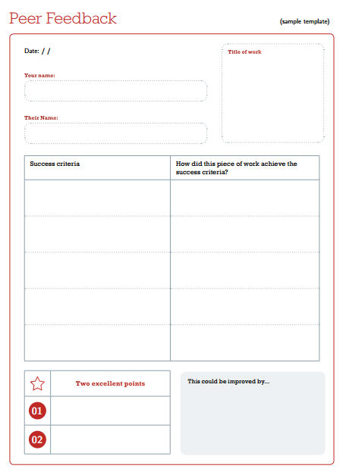
Peer Feedback Form

Slide 9
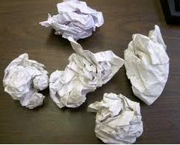
Snow Ball
Students respond to a question on a sheet of paper.
Students ball up and toss the paper around the room.
Each student collects a random paper.
Students can add to or assist students on completing problem.
They can toss as many times as you need then it comes back to them and they recomplete the problem on clean sheet.

Slide 10
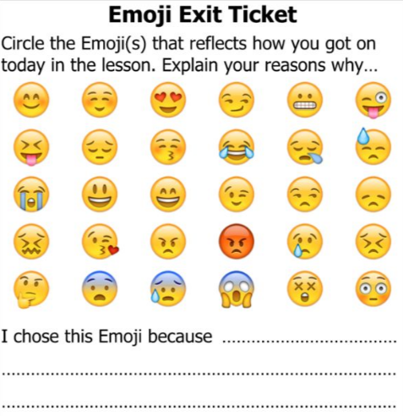
Emoji Choices
ADD: If I did not chose a happy face, describe how you are going to improve.

Slide 11
Lesson Highlights
Discuss with your students to mark on assignments.
? Not sure here
0 Need clarification
** Important

Slide 12
AT THE TOP OF EVERY PAGE…
Students can easily
Access work they need to
Work on in Rocket Fuel or Tutorial

Slide 13
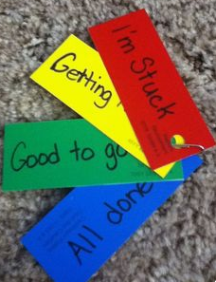
In class cards

Slide 14
Exit Tweet

Slide 15
NEXT SliDEs
Are slides to help you close the lesson and make students think about mastery of the learning target.

Slide 16
What are you confused about?
Write it down, and then ask me a SPECIFIC question that I can answer.

Slide 17
Can you do this at an expert level? Why or why not?
Separately specify what YOU could do and what I could do to help you.

Slide 18
Learning Target:
(Insert here)
Prove to me that you can complete today’s learning target independently.

Slide 19
What questions do you have about this?
Write down up to three for me to answer.

Slide 20
Fill in the Blank: (Insert statement here)
Bonus: Explain WHY the word fits into the sentence.

Slide 21
What does __________ mean?
Explain in your own words.

Slide 22
Why am I required to teach you this?
Why did the standard-makers believe that this content was important for you to know?

Slide 23
Summarize what we did today.
Write it down for someone who was absent.

Slide 24
What resources do you have to succeed on this?
Is there anything online or publicly available you can use also?

Slide 25
Summarize what we did yesterday.
Discuss with a friend. Do you both agree?

Slide 26
True or False?
Explain why.
(Insert statement here)

Slide 27
What can YOU do to learn this better?
Be specific – don’t just say “study more”.

Slide 28
Choose an answer and explain why in your own words.
Which of the following is TRUE?
(insert answer here)
(insert answer here)
(insert answer here)
(insert answer here)
(insert answer here)

Slide 29
If the test happened TODAY, how would it go?
What could you do for it to go even better?

Slide 30
Pretend you were absent today. Explain to a friend what they would miss.
Can you predict logically? Is this information stated somewhere?

Slide 31
When your parents ask, “What did you learn in school today?”, what should you say?
Be as specific as possible.

Slide 32
Why do you think people struggle with this?
How can we fix that?

Slide 33
What do you know now that you didn’t know before?
What are you now able to do?

Slide 34
Choose an answer and explain why in your own words.
Which of the following is NOT true?
(insert answer here)
(insert answer here)
(insert answer here)
(insert answer here)

Slide 35
What questions do you think will be on the test?
If so, how should you study?

Slide 36
Explain your answer to a new student.
Why will ________ matter throughout this entire school year?

Slide 37
What is the ONE thing you could do TODAY to learn more about __________?
Think beyond the obvious ☺

Slide 38
Don’t just think about academics.
Why does _________ matter throughout the rest of your life? (How will you use or apply it?)

Slide 39
If we made a study guide together right now, what would be on it?
… and how much of it would you be able to answer?

Slide 40
How will you remember this in 6 months?
Name a strategy or mnemonic device.

Slide 41
How will you still remember this when you graduate?
How can you put this into your long-term memory?

Slide 42
Turn & Talk:
(Insert assessment name here)
What is the next assessment due date?
What still needs to be done?
What small, specific steps will you take to complete it?

Slide 43
Our Current Unit topic:
(Insert unit or topic here)
How could you teach this to someone in the grade below you?
What would you tell them?
How would you show them?

Slide 44
Our Current Unit topic:
(Insert unit or topic here):
What would you say and do if you needed to teach this content to a CHILD?

Slide 45
What can you tell next year’s students about how to do this WELL?
Be as specific as possible.

Slide 46
If you could start this (unit/course)over again, what would you do differently?
Is it too late to do these? Can you finish the year strong?

Slide 47
What is the MOST important idea that you learned in class this week?
Why do you think so?

Slide 48
What made this happen?
How are you a different ________ now, compared to the beginning of the year?
How can you still get better?

Slide 49
Do you see yourself as a ____________?
Why or why not?

Slide 50
Turn & Talk
Will ____ still be important or necessary in 20 years? Why or why not?
(Insert topic here)

Slide 51
Connect what we have learned to at least ONE other academic class.
Can this apply or appear in another content area?

Slide 52
Turn & Talk
(Insert topic here)
In 60 seconds or less, tell the “story” of everything we have learned and completed in this unit from beginning to end.

Slide 53
Could this appear on a standardized test?
What would the question look like? How would you answer it?

