Slide 2
Every student deserves a great teacher, not by chance, but by design.

Slide 3



Slide 4

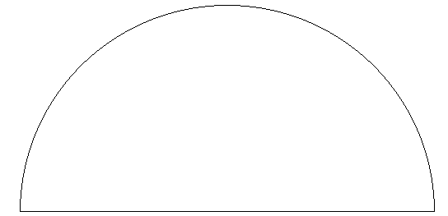
0.4
0.5
0.6
0.3
0.7
0.2
Medium
0.8
0.1
High
0.9
Low
0.0
1.0
Teacher effects
1.1
-0.1
Developmental effects
Negative
1.2
-0.2
Reverse effects
Zone of desired effects
Hattie, J. (2009). Visible learning: A synthesis of over 800 meta-analyses related to achievement.
New York: Routledge.
Notes:
Standard error =
Rank: /136
Number of meta-analyses:
Number of studies:
Number of participants:

Slide 5
0.4
0.5
0.6
0.3
0.7
0.2
Medium
0.8
0.1
High
0.9
Low
0.0
1.0
Teacher effects
1.1
-0.1
Developmental effects
Negative
1.2
-0.2
Reverse effects
Zone of desired effects
Hattie, J. (2009). Visible learning: A synthesis of over 800 meta-analyses related to achievement.
New York: Routledge.
Notes:
Standard error = n/a
Rank: 136/136
Number of meta-analyses: 7
Number of studies: 207
Number of participants: 13,938

Slide 6
0.4
0.5
0.6
0.3
0.7
0.2
Medium
0.8
0.1
High
0.9
Low
0.0
1.0
Teacher effects
1.1
-0.1
Developmental effects
Negative
1.2
-0.2
Reverse effects
Zone of desired effects
Hattie, J. (2009). Visible learning: A synthesis of over 800 meta-analyses related to achievement.
New York: Routledge.
Notes:
Standard error = 0.016 (low)
Rank: 125/136
Number of meta-analyses: 2
Number of studies: 92
Number of participants: n/a

Slide 7
0.4
0.5
0.6
0.3
0.7
0.2
Medium
0.8
0.1
High
0.9
Low
0.0
1.0
Teacher effects
1.1
-0.1
Developmental effects
Negative
1.2
-0.2
Reverse effects
Zone of desired effects
Hattie, J. (2009). Visible learning: A synthesis of over 800 meta-analyses related to achievement.
New York: Routledge.
Notes:
Std. error = 0.027 (low)
Rank: 88/136
Number of meta-analyses: 5
Number of studies: 161
Number of effects: 295
Number of participants: 105,282

Slide 8
0.4
0.5
0.6
0.3
0.7
0.2
Medium
0.8
0.1
High
0.9
Low
0.0
1.0
Teacher effects
1.1
-0.1
Developmental effects
Negative
1.2
-0.2
Reverse effects
Zone of desired effects
Hattie, J. (2009). Visible learning: A synthesis of over 800 meta-analyses related to achievement.
New York: Routledge.
Notes:
Standard error = 0.081 (high)
Rank: 58/136
Number of meta-analyses: 8
Number of studies: 674
Number of participants: n/a

Slide 9
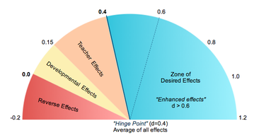
This is the hinge point –
a year’s worth of growth for a year in school.

Slide 10
0.4
0.5
0.6
0.3
0.7
0.2
Medium
0.8
0.1
High
0.9
Low
0.0
1.0
Teacher effects
1.1
-0.1
Developmental effects
Negative
1.2
-0.2
Reverse effects
Zone of desired effects
Retention: d = - 0.13
Hattie, J. (2009). Visible learning: A synthesis of over 800 meta-analyses related to achievement.
New York: Routledge.
Notes:
Standard error = n/a
Rank: 136/136
Number of meta-analyses: 7
Number of studies: 207
Number of participants: 13,938

Slide 11
0.4
0.5
0.6
0.3
0.7
0.2
Medium
0.8
0.1
High
0.9
Low
0.0
1.0
Teacher effects
1.1
-0.1
Developmental effects
Negative
1.2
-0.2
Reverse effects
Zone of desired effects
Ability Grouping/Tracking: d = 0.12
Hattie, J. (2009). Visible learning: A synthesis of over 800 meta-analyses related to achievement.
New York: Routledge.
Notes:
Standard error = 0.045
Rank: 112/136
Number of meta-analyses: 14
Number of studies: 500
Number of participants: 1,369

Slide 12
0.4
0.5
0.6
0.3
0.7
0.2
Medium
0.8
0.1
High
0.9
Low
0.0
1.0
Teacher effects
1.1
-0.1
Developmental effects
Negative
1.2
-0.2
Reverse effects
Zone of desired effects
Homework: d = .29
Hattie, J. (2009). Visible learning: A synthesis of over 800 meta-analyses related to achievement.
New York: Routledge.
Notes:
Std. error = 0.027 (low)
Rank: 88/136
Number of meta-analyses: 5
Number of studies: 161
Number of effects: 295
Number of participants: 105,282

Slide 13
0.4
0.5
0.6
0.3
0.7
0.2
Medium
0.8
0.1
High
0.9
Low
0.0
1.0
Teacher effects
1.1
-0.1
Developmental effects
Negative
1.2
-0.2
Reverse effects
Zone of desired effects
Small group learning: d = 0.49
Hattie, J. (2009). Visible learning: A synthesis of over 800 meta-analyses related to achievement.
New York: Routledge.
Notes:
Standard error = n/a
Rank: 48/136
Number of meta-analyses: 2
Number of studies: 78
Number of participants: 3,472

Slide 14
0.4
0.5
0.6
0.3
0.7
0.2
Medium
0.8
0.1
High
0.9
Low
0.0
1.0
Teacher effects
1.1
-0.1
Developmental effects
Negative
1.2
-0.2
Reverse effects
Zone of desired effects
Study Skills: d = 0.59
Hattie, J. (2009). Visible learning: A synthesis of over 800 meta-analyses related to achievement.
New York: Routledge.
Notes:
Standard error = n/a
Rank: 48/136
Number of meta-analyses: 2
Number of studies: 78
Number of participants: 3,472

Slide 15
0.4
0.5
0.6
0.3
0.7
0.2
Medium
0.8
0.1
High
0.9
Low
0.0
1.0
Teacher effects
1.1
-0.1
Developmental effects
Negative
1.2
-0.2
Reverse effects
Zone of desired effects
Repeated Reading: d = 0.67
Hattie, J. (2009). Visible learning: A synthesis of over 800 meta-analyses related to achievement.
New York: Routledge.
Notes:
Standard error =
Rank:
Number of meta-analyses:
Number of studies:
Number of participants: 5,028

Slide 16
0.4
0.5
0.6
0.3
0.7
0.2
Medium
0.8
0.1
High
0.9
Low
0.0
1.0
Teacher effects
1.1
-0.1
Developmental effects
Negative
1.2
-0.2
Reverse effects
Zone of desired effects
Teacher-Student relationships: d = 0.72
Hattie, J. (2009). Visible learning: A synthesis of over 800 meta-analyses related to achievement.
New York: Routledge.
Notes:
Standard error =
Rank:
Number of meta-analyses:
Number of studies:
Number of participants: 5,028

Slide 17
0.4
0.5
0.6
0.3
0.7
0.2
Medium
0.8
0.1
High
0.9
Low
0.0
1.0
Teacher effects
1.1
-0.1
Developmental effects
Negative
1.2
-0.2
Reverse effects
Zone of desired effects
Classroom Discussion: d = 0.82
Hattie, J. (2009). Visible learning: A synthesis of over 800 meta-analyses related to achievement.
New York: Routledge.
Notes:
Standard error =
Rank:
Number of meta-analyses:
Number of studies:
Number of participants: 677

Slide 18
0.4
0.5
0.6
0.3
0.7
0.2
Medium
0.8
0.1
High
0.9
Low
0.0
1.0
Teacher effects
1.1
-0.1
Developmental effects
Negative
1.2
-0.2
Reverse effects
Zone of desired effects
Teacher Clarity: d = 0.90
Hattie, J. (2009). Visible learning: A synthesis of over 800 meta-analyses related to achievement.
New York: Routledge.
Notes:
Standard error = 0.079 (Medium)
Rank: 3/136
Number of meta-analyses: 2
Number of studies: 30
Number of participants: 3835

Slide 19


Slide 20


Slide 21
Difficulty v. Complexity
Difficulty
Complexity
A measure of effort required to complete a task.
In assessment, a function of how many people can complete the task correctly.
A measure of the thinking, action, or knowledge that is needed to complete the task.
In assessment, how many different ways can the task be accomplished.

Slide 24

Enamored with Hard Tasks?
Marc Umile is among a group of people fascinated with pi, a number that has been computed to more than a trillion decimal places. He has recited pi to 15,314 digits.

Slide 25
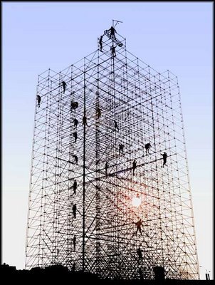
Differentiate according to difficulty, not complexity.

Slide 26
More Complex
Low Difficulty
High Complexity
High Difficulty
High Complexity
Easy
Hard
Low Difficulty
Low Complexity
High Difficulty
Low Complexity
Less Complex

Slide 27
More Complex
Strategic Thinking
Expertise
Low Difficulty
High Complexity
High Difficulty
High Complexity
Easy
Hard
Low Difficulty
Low Complexity
High Difficulty
Low Complexity
Fluency
Stamina
Less Complex

Slide 28

Learning
Intentions
&
Success
Criteria

Slide 29
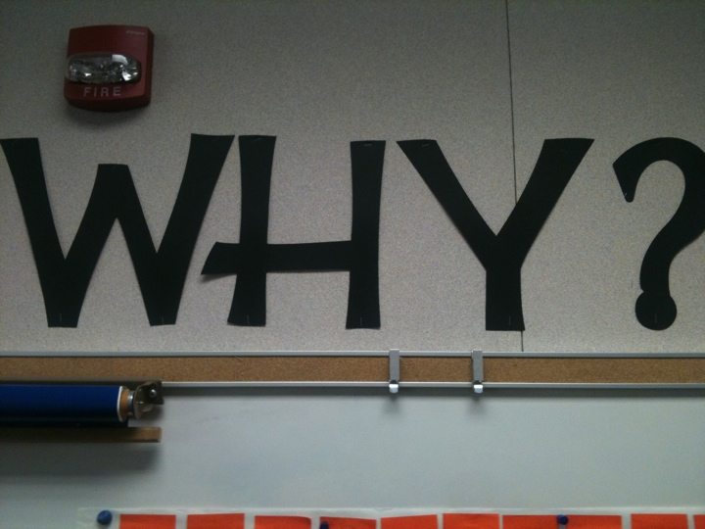

Slide 30
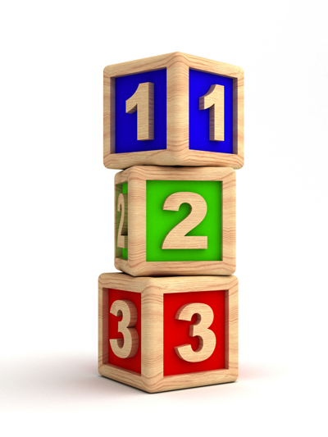
Three Questions
What am I learning today?
Why am I learning this?
How will I know that I have learned it?

Slide 31
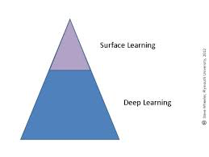
Surface Learning Versus Deep Learning
Surface learning: Learning in order to reproduce; learning the “signs”
Deep learning: Learning in order to understand; learning what the “signs” signify
Marton & Saljo, 1976

Slide 32
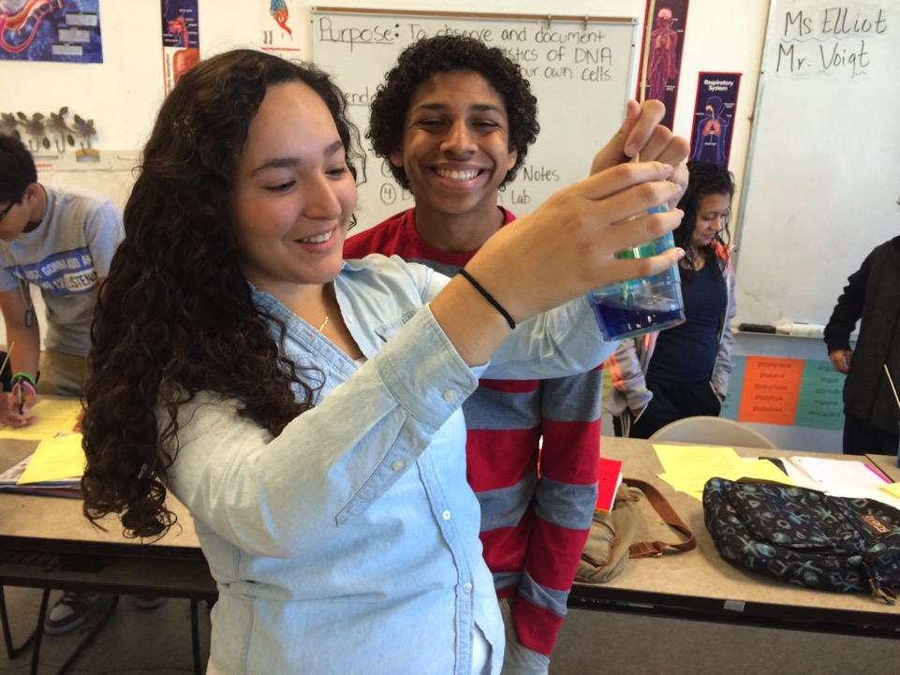
Surface Learning is IMPORTANT
How do you
get help?
How do you
know when
you’re done?
What are you
learning?

Slide 33
Ways to Facilitate Surface Learning
Leveraging prior knowledge (d=0.67)
Vocabulary techniques (sorts, word cards, mnemonics, etc.) (d=0.67)
Reading Comprehension in Context (d=0.60)
Wide reading on the topic under study (d=0.42)
Summarizing (d=0.59)

Slide 34
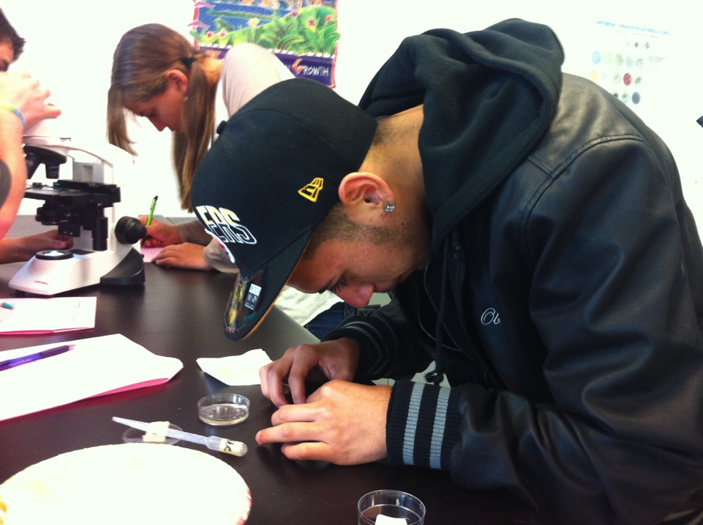
Deep Learning is Also Important

Slide 35
Ways to Facilitate Deep Learning
Concept mapping (d=0.60)
Discussion and questioning (d=0.82)
Metacognitive strategies (d=0.69)
Reciprocal teaching (d=0.74)

Slide 36

Deep learning approaches don’t work any better at developing surface learning than surface learning strategies work to develop deep understanding.

Slide 37

Transfer
Deep
Surface

Slide 38

Transfer Goals

Slide 39
“The ability to transfer is arguably the long-term aim of all education. You truly understand and excel when you can take what you have learned in one way or context and use it in another, on your own.”
(McTighe & Wiggins, 2011)

Slide 40
Speaking & Listening
9th - Knowing how to listen to someone who knows something you don’t know and ask clarifying questions.
10th - Being open and respectful enough to imagine that a new and strange idea is worth paying attention to.
Upper Division (11th and 12th) - Being inclined to ask questions about statements hiding widespread assumptions or confusions.

Slide 41
Ways to Facilitate Transfer
Reading across documents to conceptually organize (d=0.85)
Formal discussion, including debates and Socratic seminars (d=0.82)
Problem-solving teaching (d=0.61)
Extended writing (d=0.43)

Slide 42

www.fisherandfrey.com

